Slide 1

Situation-Aware Cluster and Quantization Level
Selection Algorithm
for Fast Federated Learning
Sangheon Pack
Sangwon Seo
Jaewook Lee
Haneul Ko

Slide 2
SITUA-CQ Algorithm
Federated Learning

Slide 3
Abstract
I. Federated Learning
II. System model
III. Accuracy
IV. SITUA-CQ algorithm
V. Result

Slide 4
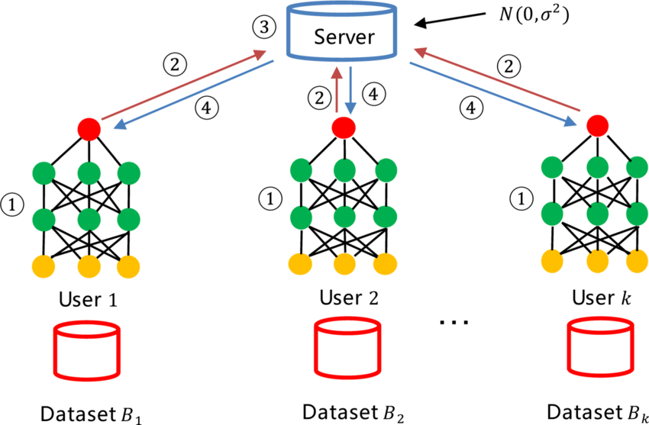

What is Federated Learning?
Privacy

Slide 5
What is Federated Learning?

Slide 6

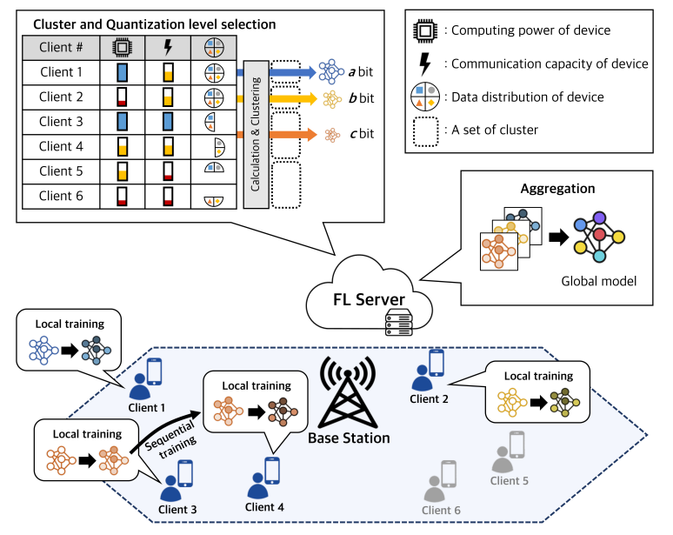
System model
System process

Slide 7
Performance
reporting

Slide 8
2. Cluster
3. Round time estimate

Slide 9
4. Quantization
level section

Slide 10
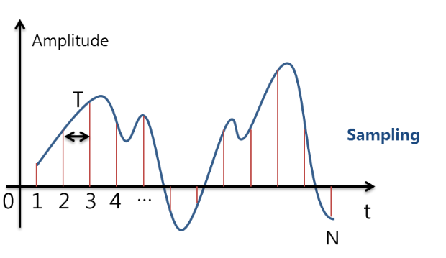
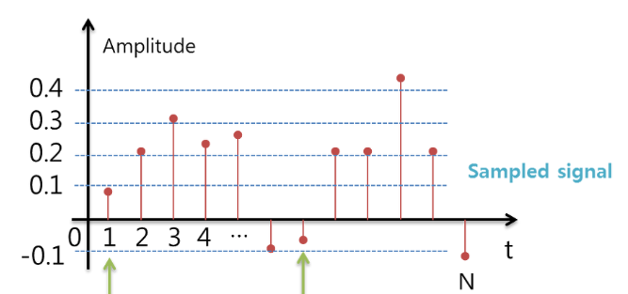
Quantization level?
0.1
-0.1

Slide 11
5. Local training

Slide 12
5. Aggregation

Slide 13
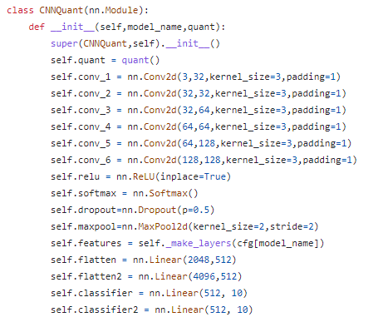
Deep model
6 layers
32, 64, 126 filters
Relu, Max-pooling

Slide 14
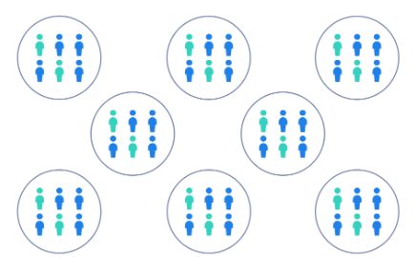
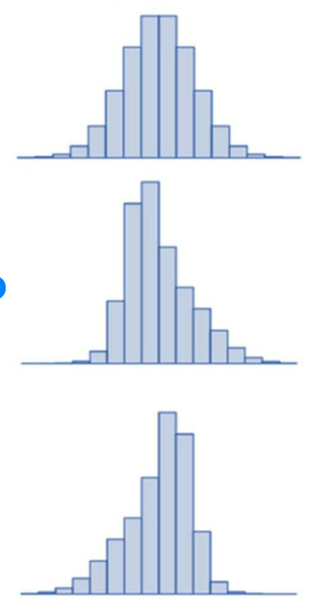
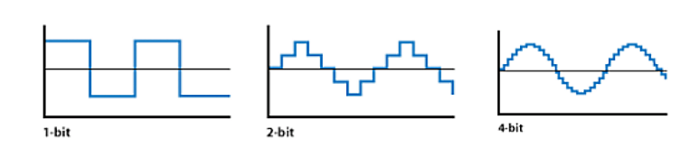
Number of clusters
Accuracy
Quantization level
Data Distribution

Slide 15
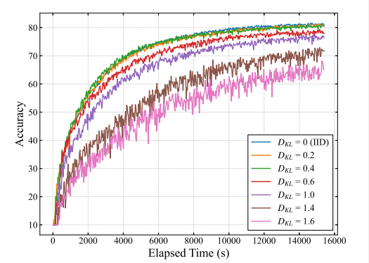
Effect data distribution of clusters
on the accuracy

Slide 16
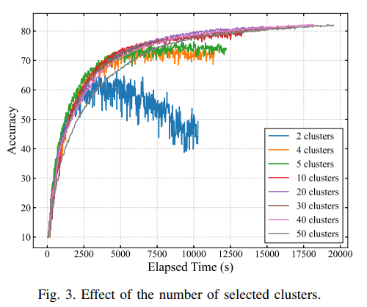
Effect of the number of selected clusters

Slide 17
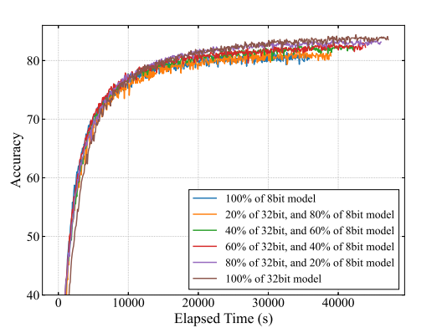
Effect of the distribution of quantization levels

Slide 18
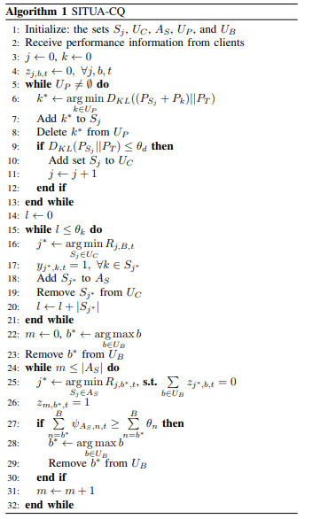
SITUA-CQ
Cluster clients according data distribution of clients
Chose cluster with faster round time
Until target number of clients
Allocate quantization level to selected cluster

Slide 19
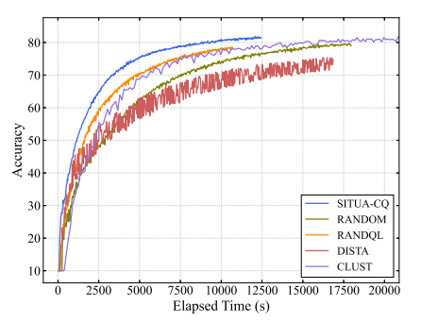
Result
Accuracy curve of SITUA-CQ

Slide 20

Thank you

